Slide 1
TutorChatAI
The AI Tutor That Works for Schools
www.TutorChatAI.com
Founder: Jeremy Kruid

Slide 2
The Problem
- Schools struggle to recruit and fund human tutors
- Students lack timely, personalized academic support
- Existing AI tools are not built for classrooms or curriculum

Slide 3
The Solution
TutorChatAI.com – GPT-4-powered AI tutoring, purpose-built for institutions
✅ On-demand help in math, science, writing
✅ LMS & SIS integration (PeopleSoft, D2L) (Q4)
✅ Curriculum-aligned, FERPA-compliant, scalable

Slide 4
Traction
- GPT-4 model live
- Pilot interest from Texas college and charter network
- Outcome assessment launched Q3–Q4
- PeopleSoft integration scheduled next quarter
- Co-branded deployments planned for Q1 2026

Slide 5
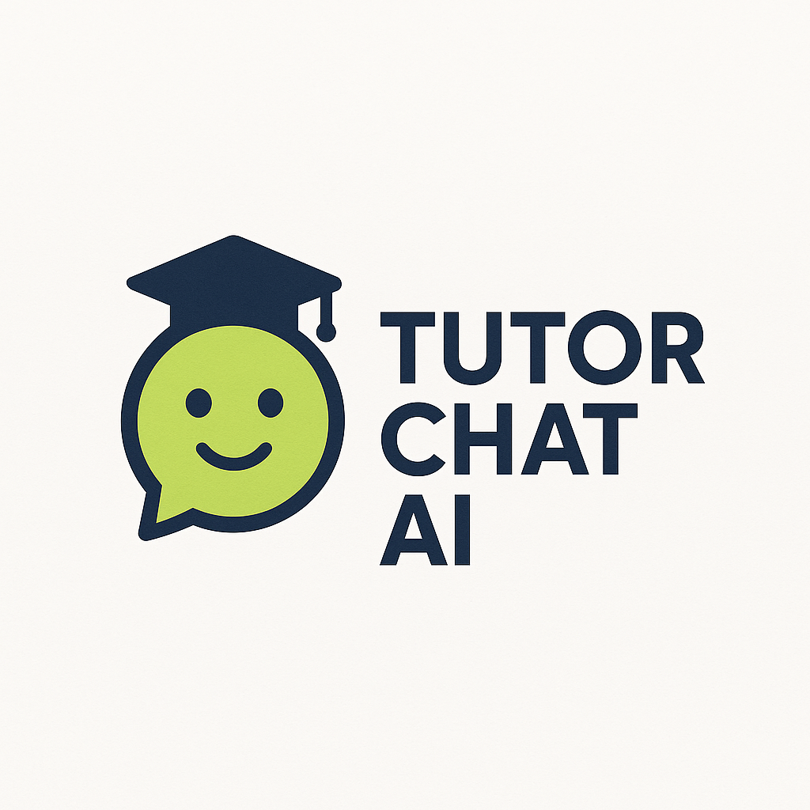
Product Demo
Live demo includes:
- Student interface
- Admin dashboard

Slide 6
Market & Business Model
- $10B+ U.S. tutoring market
- Annual SaaS licensing to schools
- Target: $10–$15 per student/year
- Expansion to state-level contracts & edtech marketplaces

Slide 7
Competitive Edge
Khanmigo: TutorChatAI has custom integrations, outcome tracking
MagicSchool.ai: Focused on tutoring, not teacher tools
Brainly: Institutional licensing, analytics
Quizlet: Deeper reasoning, curriculum alignment

Slide 8
The Ask
📌 Raising $300,000 for final development + pilot scale
📌 Seeking strategic education-aligned investors
📌 Let’s change how students get help—together

